Slide 1
Volunteer Training part 1

Slide 2
Goal FOR TODAY:
To strengthen your ability to HELP the kids you tutor go beyond HEARING to KNOWING.

Slide 3
What do we want kids to know?

Slide 4
3 Barriers

Slide 5
Good news
”Good Enough Tutoring”
Relationships are not like bones.
Bidirectional Messages
Mirror Neurons can work for you.

Slide 6
Barrier #1 Misconceptions about trauma

Slide 7
3 E’s of Trauma
Event (ACEs)
Experience (Overwhelmed)
Effect (January)
Trauma = Event + Experience + Effect

Slide 8
Barrier #2 Misconceptions about behavior

Slide 10
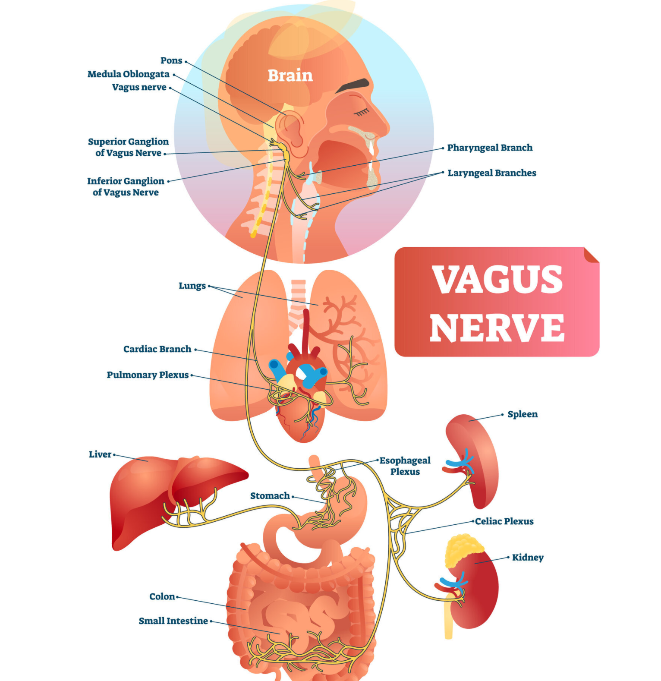
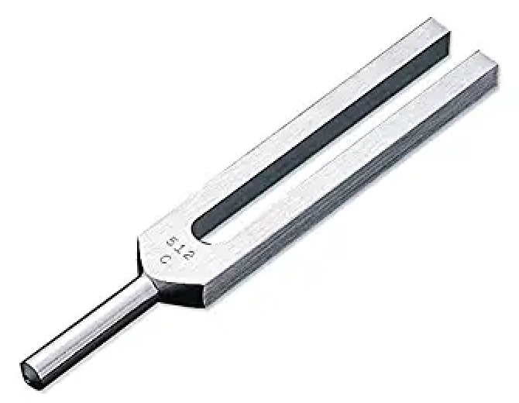

Slide 11
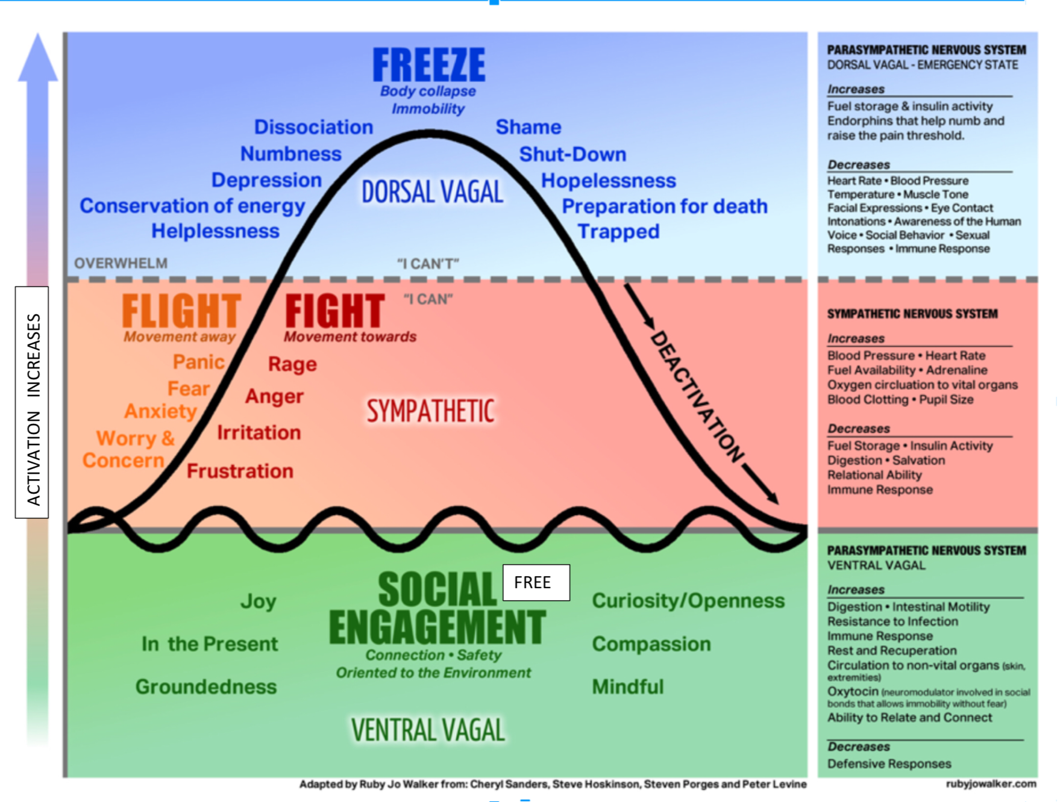
brake
Life Threat
gas pedal
Danger
coasting
Safety

Slide 12
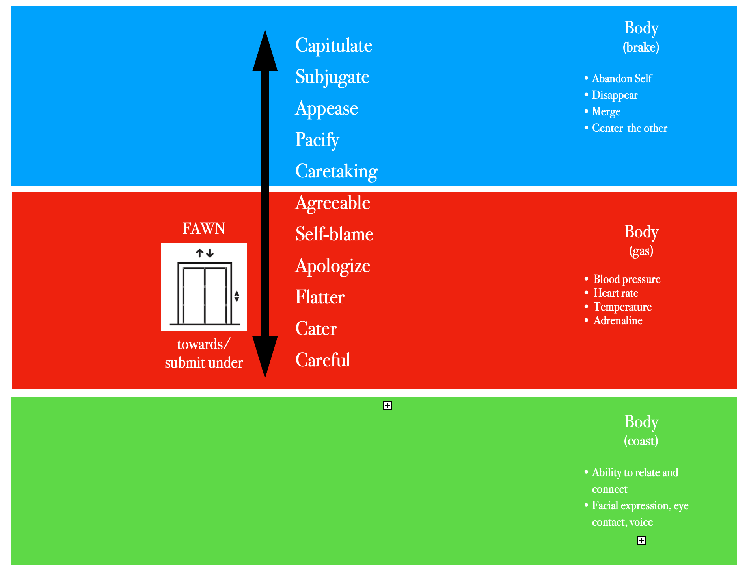

Slide 13
Barrier #3 Our inability to help (not just tell) kids to calm down

Slide 14
There is no regulation
without co-regulation.

Slide 15
Calming principles
Movement (dispersing energy)
Feet above heart
Temperature change (cold to hot to cool)
Longer exhales than inhales
Alternating Left/Right exercise
Rhythmic & Repetition
Grounding: 5 senses

Slide 18
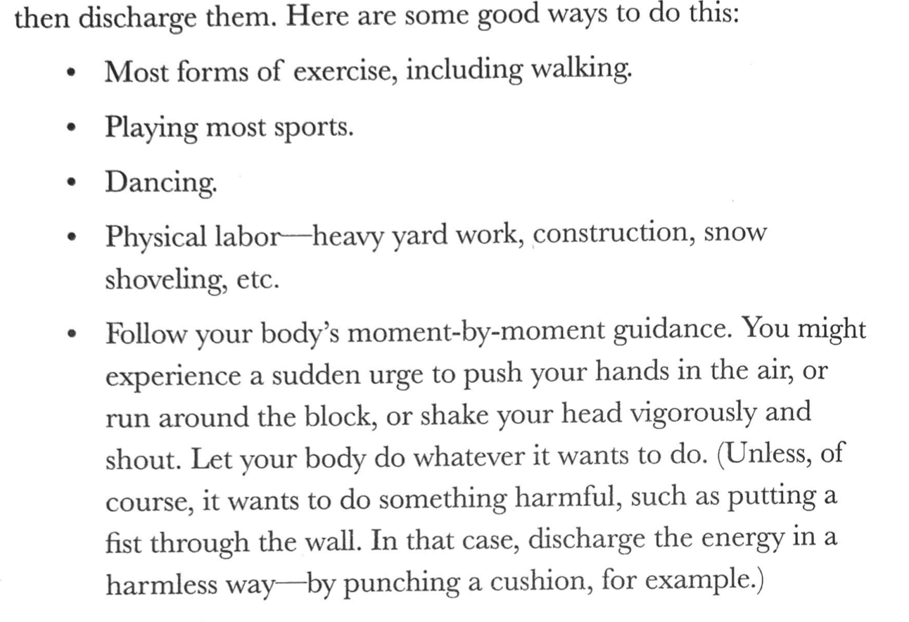

Slide 19
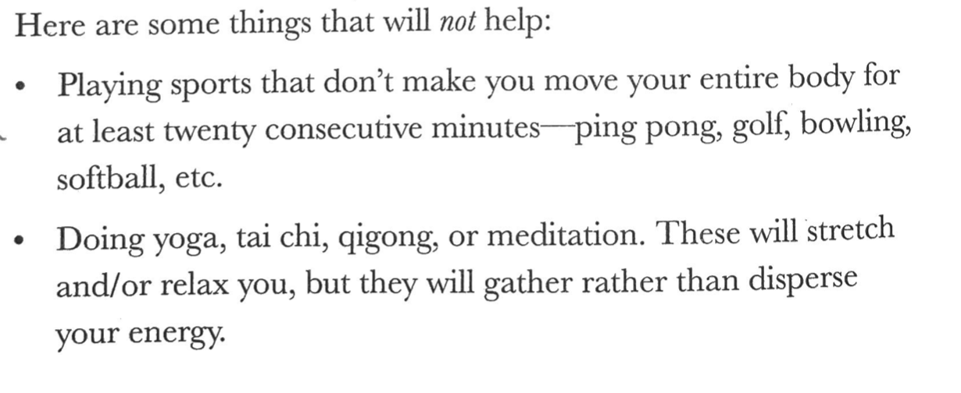

Slide 20
Calming practices
Temperature: drinks, objects (drinks, washing hands, ice, rubbing hands together)
Breathing: Starfish Breathing Exercise for Kids
Alternating Left/Right Movement:
Walking, 100 butterfly taps, knee taps, non-dominant hand journaling exercise
Rhythmic Repetition
Humming, Rocking (swing, chair, hammock), Jump Roping
Five Senses: Mindfulness Grounding Exercise
See 5, feel 4, hear 3, smell 2, taste 1

Slide 21
