Slide 1
Whiz kids Volunteer Training part 2

Slide 2
How did it go?
Prayer

Slide 3
“The only person’s suffering
we have a right
to make meaning of
is our own.”
Dr. Celene Lillie

Slide 4
Shifts:
From body, mind, heart to wiring
From present to past
From presence to relationship
From the moment to the long haul
From one track to two tracks

Slide 5
Topics:
Attachment Theory
Developmental trauma’s affects on children’s brains
How do I deal with that?
Disclaimers, postures & mantras

Slide 6
Attachment theory

Slide 7
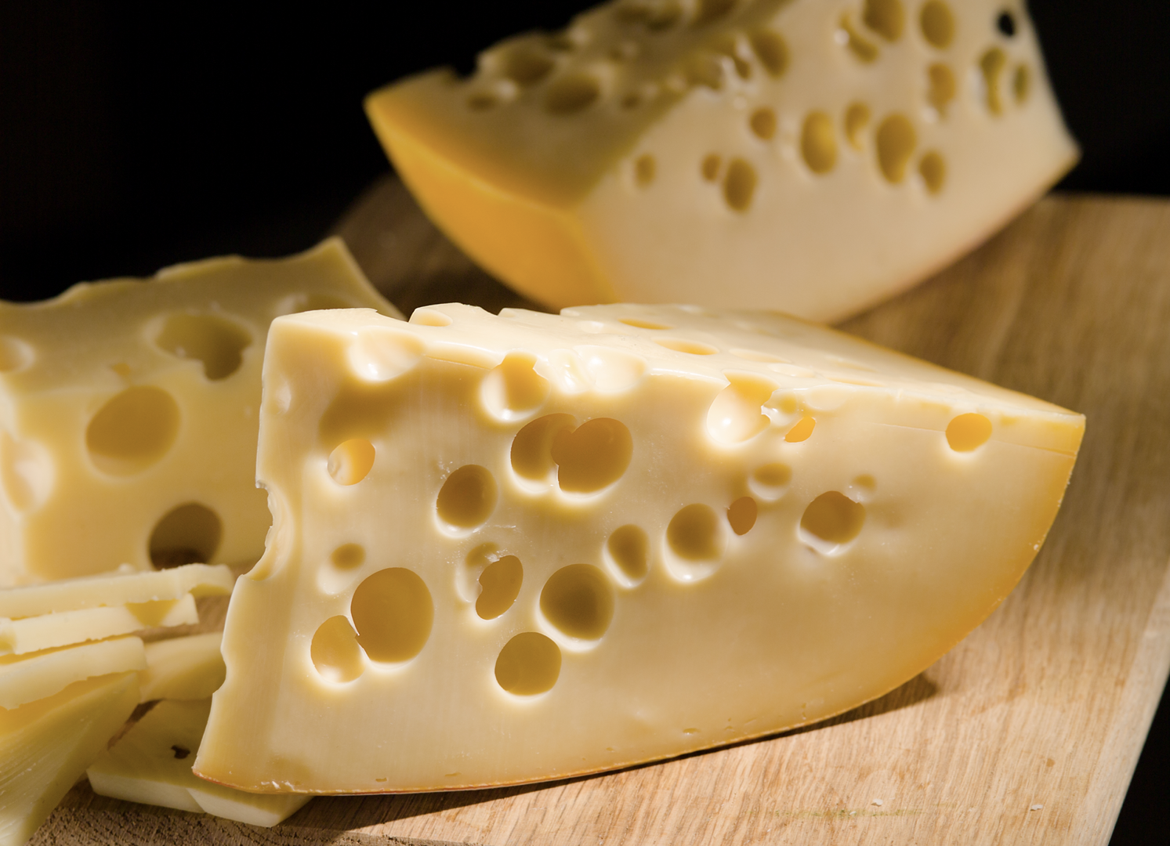
GOOD NEWS:
Earned Secure Attachment

Slide 8
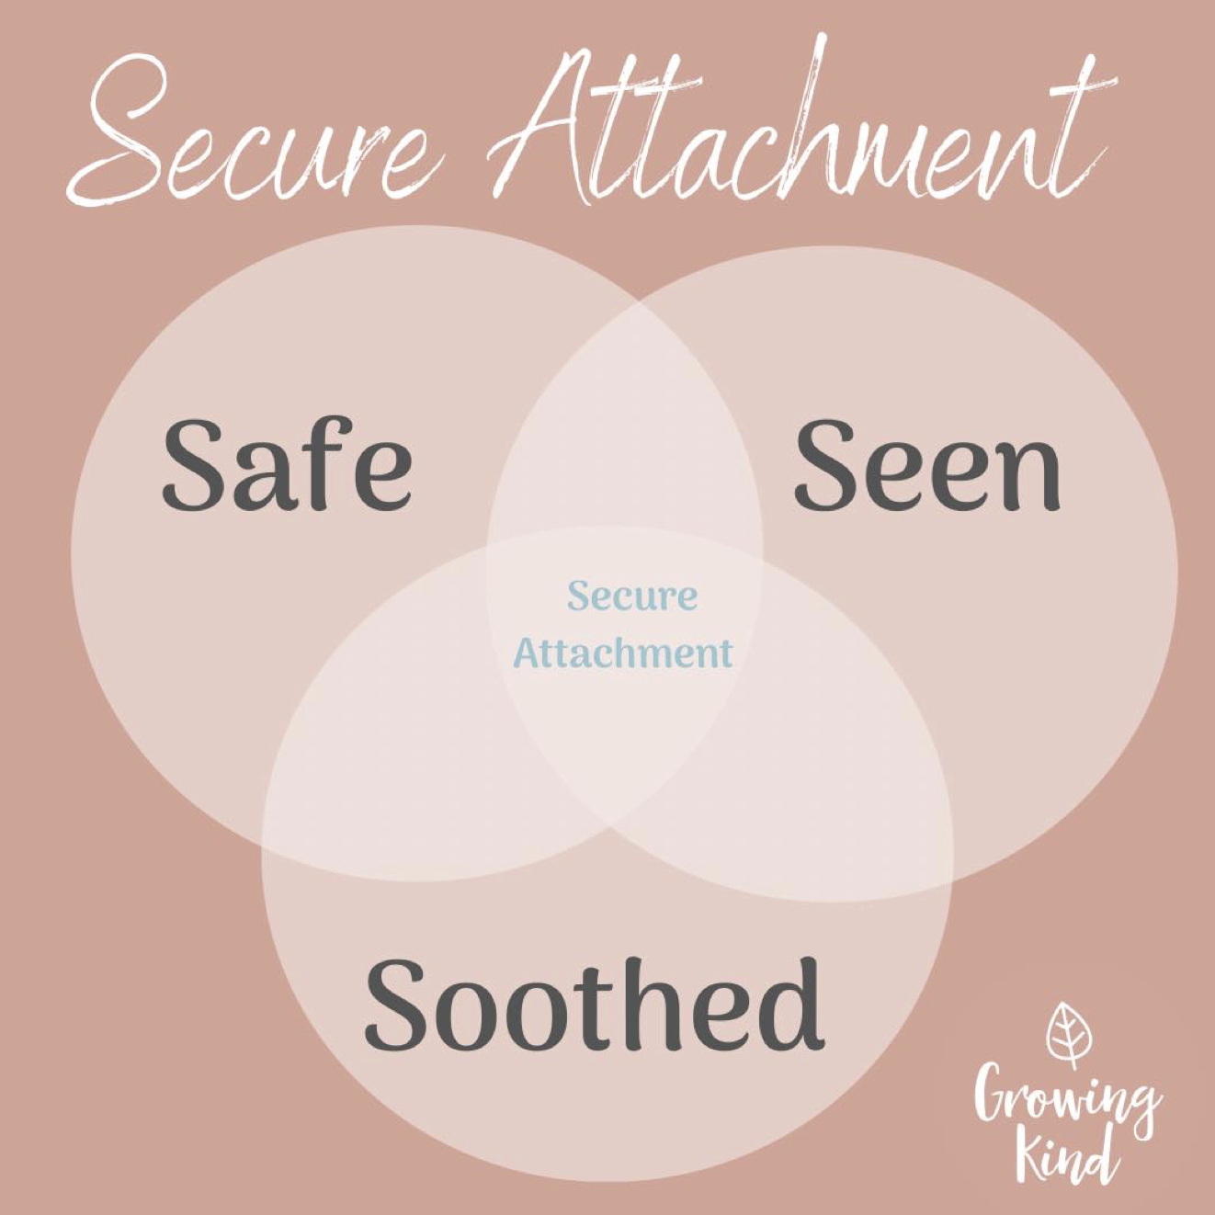

Slide 9
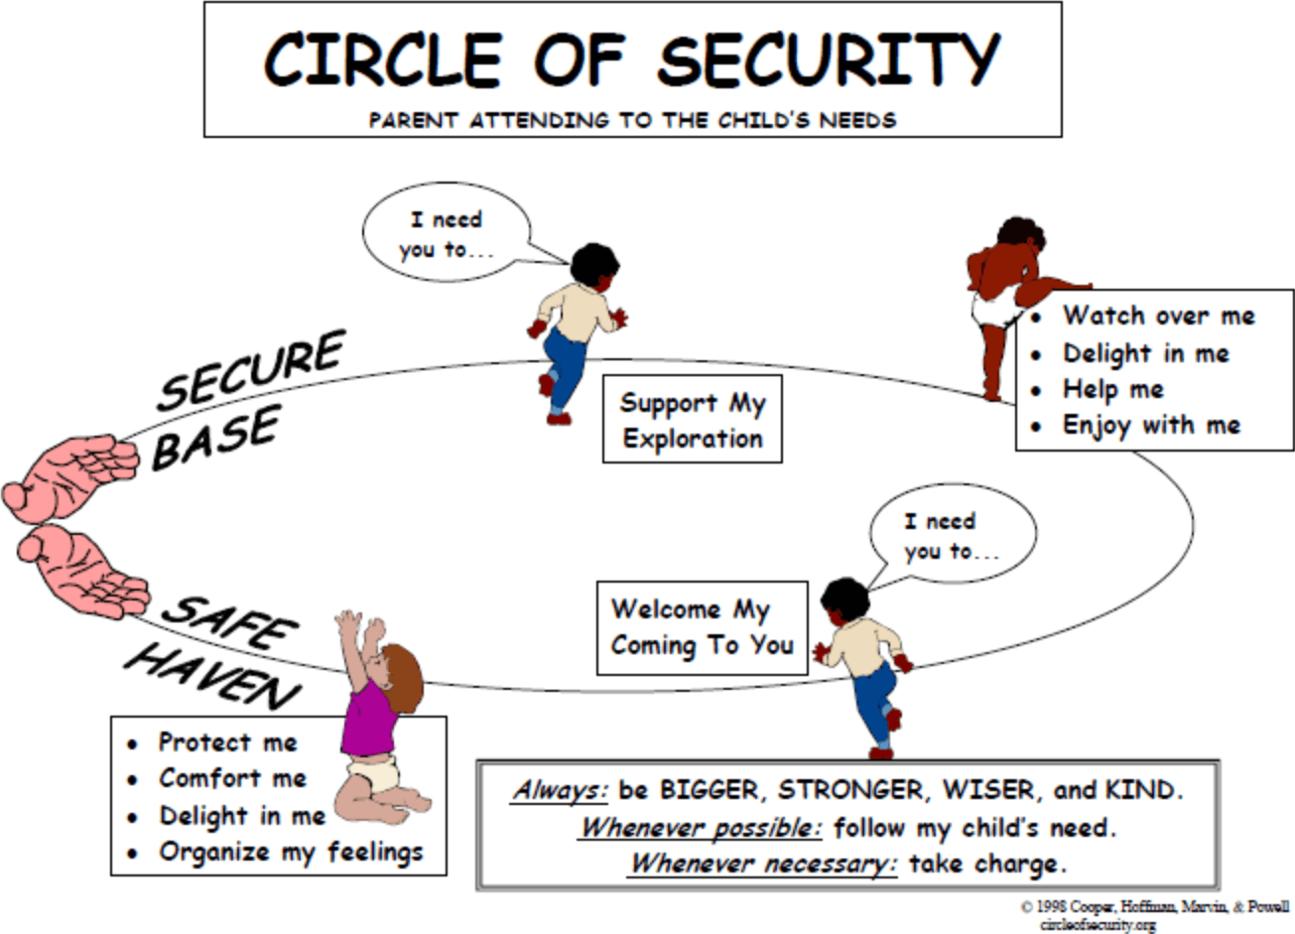

Slide 10
Trust:
You are worthy of care.
I can care for you.
Trust is the core issue for the four styles of attachment.

Slide 11
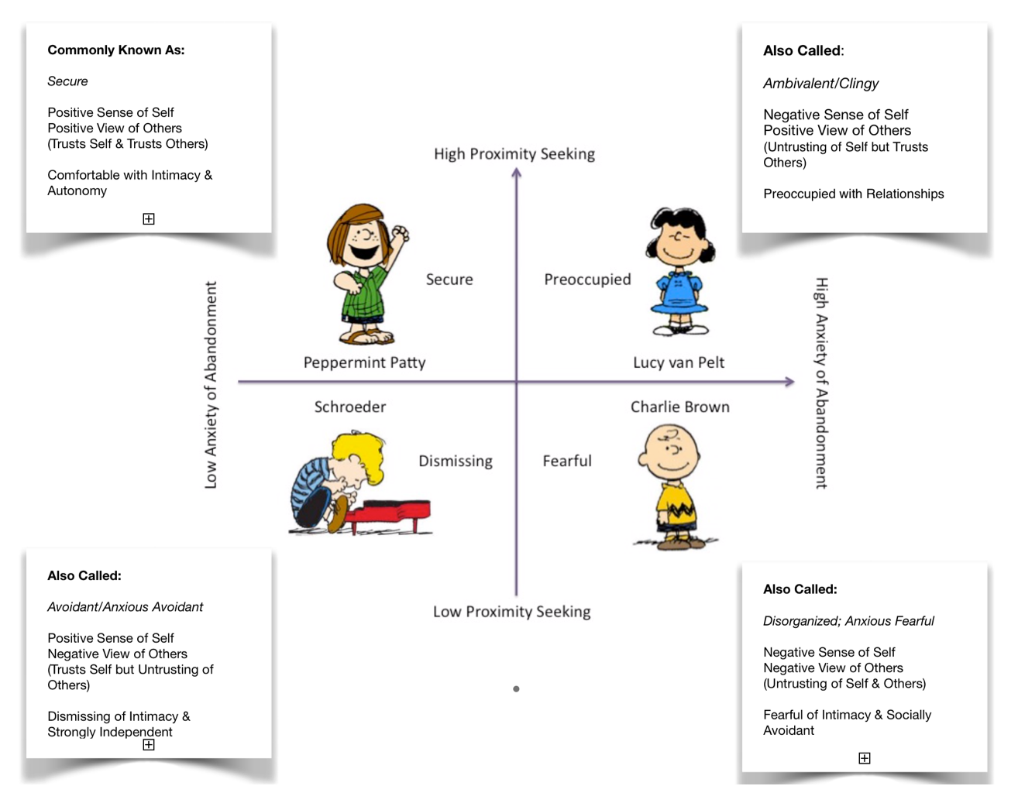

Slide 12
REFLECT
Take 5-10 minutes to think about the child you tutor.
What do you sense is their style?
What is yours?
How do they intersect?

Slide 13
DEVELOPMENTAL TRAUMA

Slide 14
Betrayal trauma
6 million CPS referrals in 2010 for abuse and neglect:
81% perpetrators were caregivers
When the parent (or home) is the source of danger there is a paradox of approach-avoidance needs.
"Fright without solution"

Slide 15
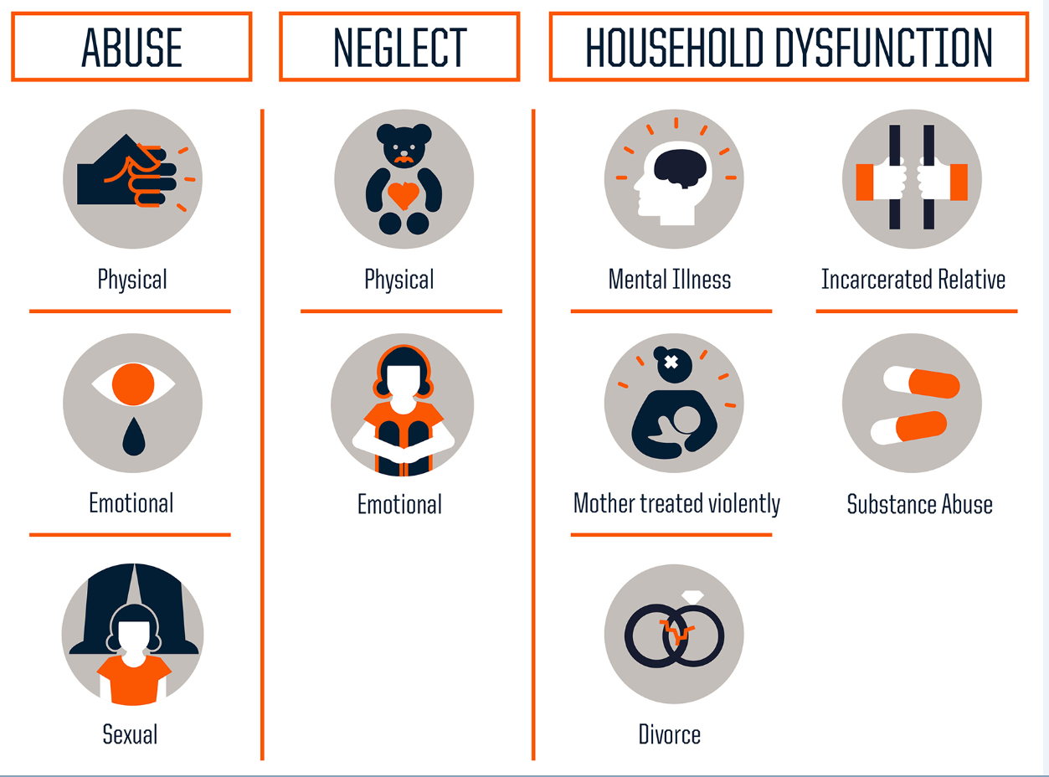
Unable or unwilling?

Slide 18
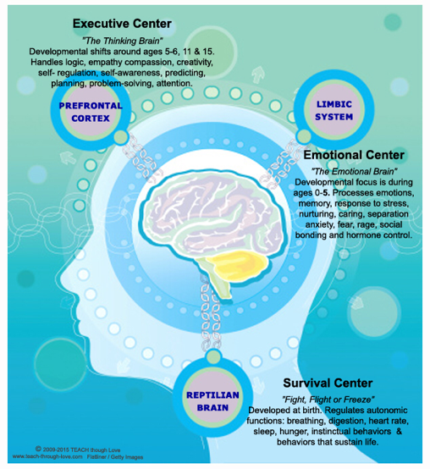
DISTORTED
UNAVAILABLE
HYPERACTIVE

Slide 19
Brain Wiring:
25 % wired by birth
75% wired by 3 years old
Trauma’s Impact on the Brain:
Timekeeper (in PFC) goes off line; eternal & time confusion; low distress tolerance
Amygdala (alarm bells): hypersensitive; going off all the time, stuck on high alert; superimpose their trauma on everything around them
Hippocampus (watch tower)
Startle in response to loud sounds, become enraged by small frustrations, freeze when touched
Thalamus (the cook)
Since the thalamus filters out body sensations (gatekeeper of awareness and focus) traumatized people are constantly on sensory overload because their “gatekeeper” has left the gate wide open (#no filter)
Symptoms:
Hypervigilance
Attention issues
Dysregulated & Disorganized

Slide 20
REFLECT
Take 5-10 minutes to think about the child you tutor.
What do you know about their home?
How does he/she protest disconnection?
What symptoms of an underdeveloped brain do you think you see?

Slide 21
How DO I deal with that?

Slide 22
3 Disclaimers
3 Postures
3 Mantras

Slide 23
DISCLAIMER:
So much harder to teach but you are highly resourced
o Spirit leads it; you’ll know when it happens and when it doesn’t
o Repair strengthens the relationship
o Remember: “good enough” tutoring is 30%!
POSTURES:
Unmet needs (not willful choice)
Creativity of His image (survived, brilliant, efficacious)
Dissociation & Shame are real, invisible forces
MANTRAS:
They are more miserable than you. You are only getting a dose!
Trust myself (30% on mark, 70% I’ll fix) & trust them (they are the expert on them)
Feel, struggle, wonder out loud; be confessional!

Slide 24
7 Core Human Desires
Heard and Understood
Affirmed
Valued/Cherished
Safe
Touched
Chosen/Desired
Included

Slide 25
Dissociation & Shame
“A lie would have no sense
unless the truth
were felt as dangerous.”
Alfred Adler

Slide 26
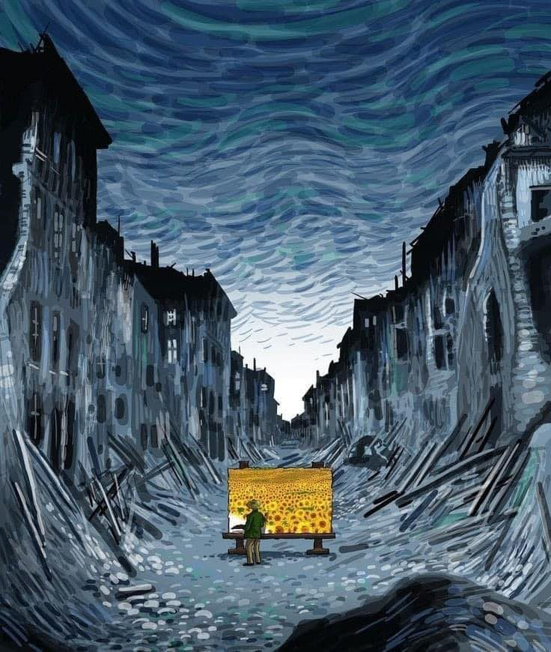

Slide 27
Future
Story: the undercurrent of our lives and the kids we work with
Dynamics of dissociation & shame in surviving our stories
Inequity in our stories: race, class, gender (lenses through which we look at unwilling and unable)

